Slide 1
Multilingual Sentiment Analysis For Hotel Reviews
PRESENTED BY :-
RIYA KUMARI -10900215060
REETIKA GAUTAM - 0900215059
POOJA PRIYA - 10900215052
RAKESH ROY CHOUDHARY - 10900215056

Slide 2
ACKNOWLEDGEMENT
It gives me great pleasure to acknowledge the guidance, assistance and support Ms. Mousita in making the Project and this Project report, which has been structured under her valued suggestion. She has helped me to accomplish the challenging task in a very short period of time .
Finally, I express the constant support of my friends and family for inspiring me throughout and encouraging me.

Slide 3
OVERVIEW
Nowadays, more and more people start to search on internet for useful information. In order to help customers finding information efficiently and attracting more customers, many websites starts to ask customers with their reviews based on their experience.
In this way, other customers could get useful information easily and choose their products based on those informations . Other customers could easily make decisions about hotels, instead of wasting amount of time to do the research.
We use three models , we first use review context to predict the overall rating. To compare those three models, we identify if the model could predict the overall rating more accurately by using rating in several aspects.
A challenge for this task was to get a good amount of accuracy with small dataset.

Slide 4
GOALS
Since we had a large amount of data missing in our dataset the primary goal was to first pre-process the data to get rid of incomplete reviews.
After getting pre-processed data we have to predict the ratings of the reviewtext according to the past data.
Some reviews had ratings less than 0 and some had more than 5 which had to be discarded for better accuracy.

Slide 5
Specification
Now that the we have three different review text fields( reviewtext , cleantext , adjectivetext) we'll start by splitting these fields into separate variables. we then found the tf-idf of the unigrams and bigrams of the three review text fields. This will then be used as the input for each of the classification algorithms. Since we were going to be using the naive bayes classifier for one of our algorithms and the dataset is fairly small, the CountVectorizer may be a better choice, but for this kernel we wanted to first try to tf-idf vectorizer and see the performance.
After running these three classifiers i.e SVM,KNN,NAÏVE BAYES, it appears the original review text seemed to be best at classifying the reviews. The accuracy scores from this analysis are just OK, where linear svc and naive bayes are both comfortably better than chance at predicting the rating of the hotel review.

Slide 6
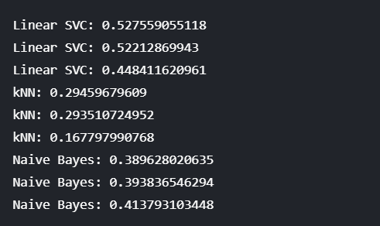
By applying all classifiers we get the below results

Slide 7
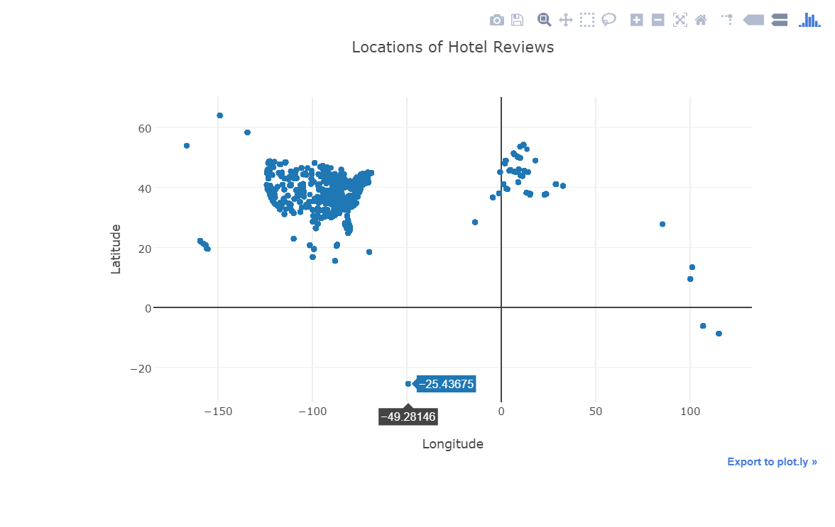
DISCUSSION
we wanted to make sure that all of the reviews were in English, since we noticed other languages in the reviews. Oddly , looking at the dataset it appears that the reviews are only for hotels in the US, but the plot below seems to pretty clearly show international hotels. filtering the data based on the latitude/longitude values seemed to do the trick to only get English reviews.

Slide 8
After we performed all 3 classifications on our pre-processed data we get the recall rates foe each classifier given below.

Slide 9
From which we conclude that our model confused a lot between a 4 star rating and a 5 star rating due to which our accuracy boils don to 52 %.from the confusion matrix of SVM (which gave the best results among the 3 ) we see that it could only correctly identify 864 correct 4 star ratings and false positive as 891 out of 2061.

Slide 10
Overall, the results are fairly good for such a small data set and considering that we did not do any feature selection or even much tuning of the classifier itself. If I had more time to properly tune the classifier, choose strong features, and evenly sample the data we are sure there would be significant performance increase in the classifier!

Slide 11
What is Support Vector Machine?
“Support Vector Machine” (SVM) is a supervised machine learning algorithm which can be used for both classification or regression challenges. However, it is mostly used in classification problems. In this algorithm, we plot each data item as a point in n-dimensional space (where n is number of features you have) with the value of each feature being the value of a particular coordinate. Then, we perform classification by finding the hyper-plane that differentiate the two classes.

Slide 12
WHAT IS KNN?
K-Nearest Neighbors (KNN) is one of the simplest algorithms used in Machine Learning. KNN algorithms use a data and classify new data points based on a similarity measures (e.g. distance function). Classification is done by a majority vote to its neighbors. The data is assigned to the class which has the most nearest neighbors. As you increase the number of nearest neighbors, the value of k, accuracy might increase.

Slide 13
What IS NAÏVE BAYES CLASSIFIER?
Naive Bayes is a machine learning algorithm for classification problems. It is based on Bayes’ probability theorem. It is primarily used for text classification which involves high dimensional training data sets. A few examples are spam filtration, sentimental analysis, and classifying news articles.
It is not only known for its simplicity, but also for its effectiveness. It is fast to build models and make predictions with Naive Bayes algorithm. Naive Bayes is the first algorithm that should be considered for solving text classification problem.
In Naive Bayes algorithm it learns the probability of an object with certain features belonging to a particular group/class. In short, it is a probabilistic classifier.
The Naive Bayes algorithm is called "naive" because it makes the assumption that the occurrence of a certain feature is independent of the occurrence of other features.

Slide 14
RESULTS
Now, using the function we plotted the confusion matrix for the top three classifiers based on the scores . These plots clearly show an issue with the data we did not address, the fact that there are many more 4,5 star ratings than any other rating, which means our classifier is going to be trained to be much better at identifying these high ratings. But even with this issue, the classifier was mainly confusing rating that were next to each other (e.g. confusing a 4 for a 5), which is understandable given how free text reviews don't always match perfectly with a star rating. Overall, the results are fairly good for such a small data set and considering that we did not do any feature selection or even much tuning of the classifier itself. If I had more time to properly tune the classifier, choose strong features, and evenly sample the data I'm sure there would be significant performance increase in the classifier!

Slide 15
CONCLUSION
We have described data preprocessing,typical features and the main resources used for multilingual sentiment analysis.
We have used three classifications (Naïve Bayes,KNN,SVM) for prediction of hotel rating from reviews .We got the most accuracy in SVM.

Slide 16
REFERENCES
https://www.kaggle.com/datafiniti/hotel-reviews(source for datasets)
http://cs229.stanford.edu/proj2014/Vikram%20Elango,%20Govindrajan%20Narayanan,%20Sentiment%20Analysis%20for%20Hotel%20Reviews.pdf(a case study on sentiment analysis)
https://plot.ly/(for ploting the statistical graphs, used in offline mode)
https://www.nltk.org/(official documentation acted as a promoter )
https://textblob.readthedocs.io/en/dev/(more options for sentiment analysis)

